Slide 1

DFS Presentation
Team – DFS Phodenge
Members :
Nikhil Agrawal (2020102021)
Atharv Sujlegaonkar (2020102025)
Mitul Garg (2020102026)

Slide 2
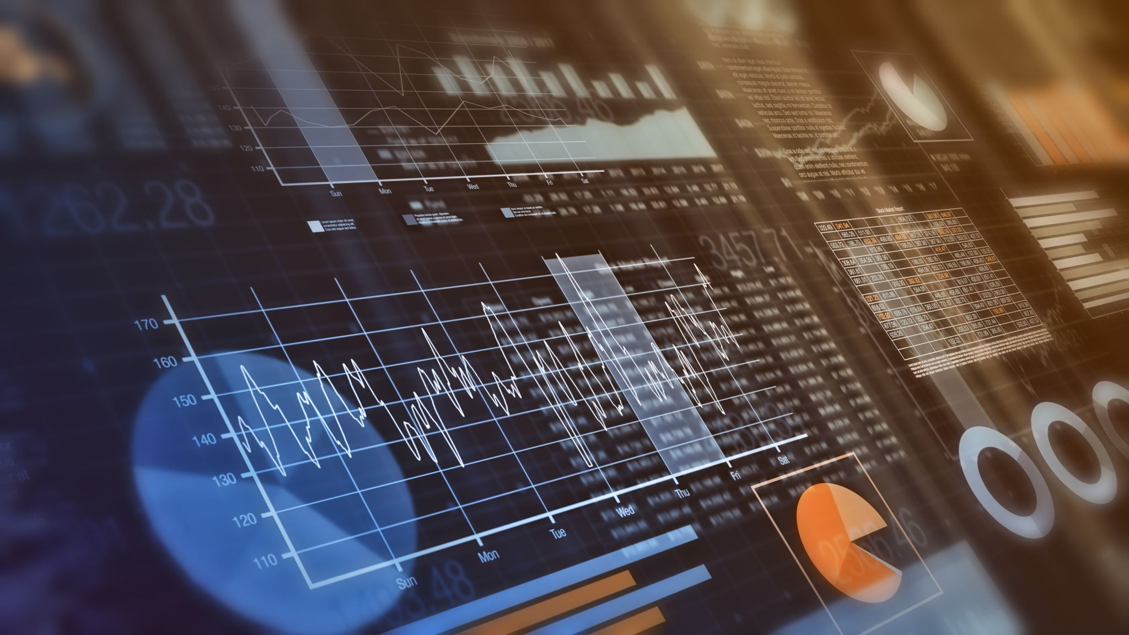
Creating a Knowledge Database Management Dashboard For patient data
Metrics for data :
Basic patient data
Medical observations
Blood reports
Imaging (Images, CT scans, MRI etc.)
Genome Sequencing Data

Slide 3

Tech Stack Used
We have used the following for knowledge graphs :
Networkx – a python library for network analysis
We have used MERN stack in our project
MongoDB — document database
Express(.js) — Node.js web framework
React(.js) — a client-side JavaScript framework
Node(.js) — the premier JavaScript web server

Slide 4
About mern stack
MERN stack is a web development technology stack that consists of four major components: MongoDB, ExpressJS, ReactJS, and Node.js.
MongoDB: It is a NoSQL database that stores data in the form of documents in JSON-like format. It is highly scalable and flexible.
ExpressJS: It is a backend web application framework that is built on top of Node.js. It provides a set of tools and libraries to build web applications quickly and easily.
ReactJS: It is a JavaScript library for building user interfaces. It allows developers to build reusable UI components and update them dynamically without the need for a page refresh.
Node.js: It is a runtime environment for executing JavaScript code outside of a browser. It provides a platform for building scalable, server-side applications using JavaScript.

Slide 5

About networkx
NetworkX is a Python library for the creation, manipulation, and study of complex networks or graphs. It provides tools for analyzing and visualizing network data, as well as algorithms for generating and modeling networks.
Networks or graphs are a collection of nodes or vertices, connected by edges or links. These networks can be used to model various real-world systems, such as social networks, transportation networks, biological networks, and more.

Slide 6

Challenges faced
Connecting the Python-written Knowledge Graph to Java-written WebApp.
Analyzing the user data fields and understanding how to deploy it efficiently on the site.
Focusing on a minimalist UI but still making it eye-catchy.
Understanding the Tech-Stack, API calls, debugging multiple errors etc.

Slide 7

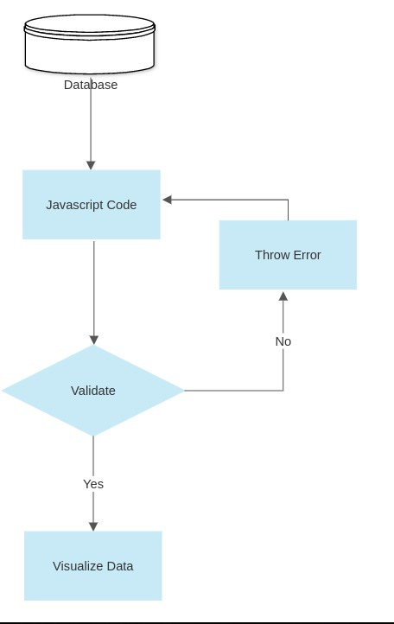
Flowchart
Insert flowchart here

Slide 8

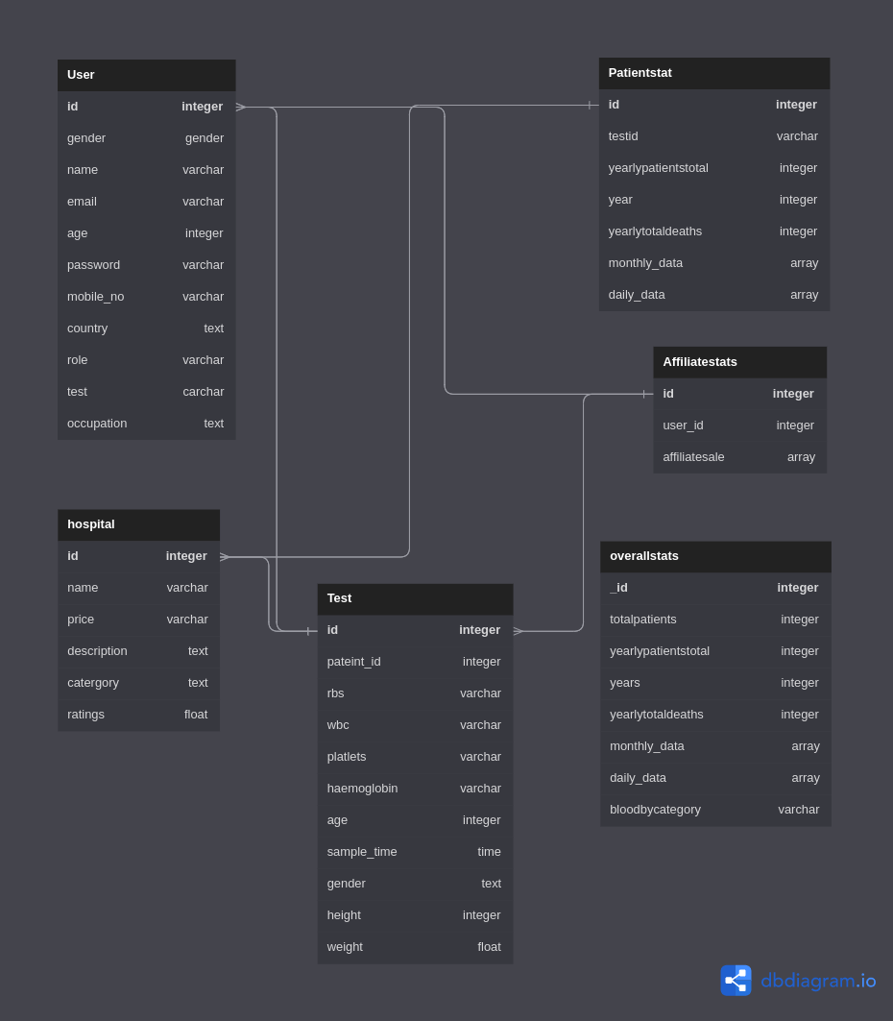
Database model
Attach er diagram aur similar here

Slide 9

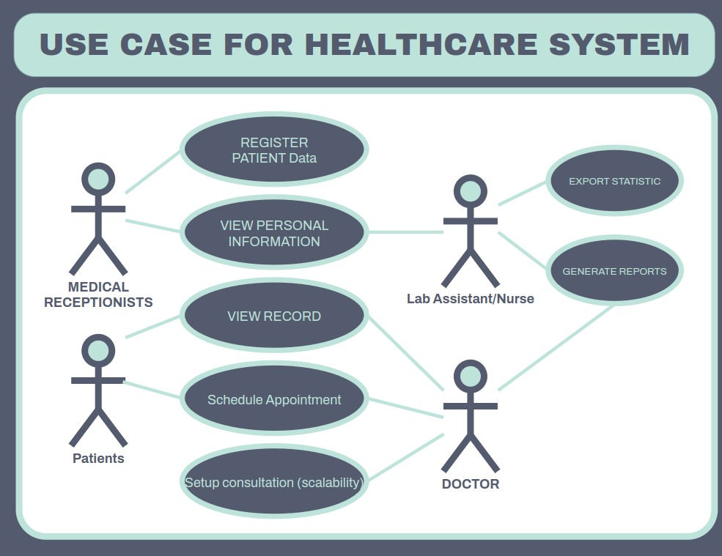
Use-case diagram

Slide 10

Objectives reached
A well-presented App with a minimalist yet informative UI.
The Knowledge Graph which is created using NetworkX which displays the relationship of data in form of Networks.

Slide 11

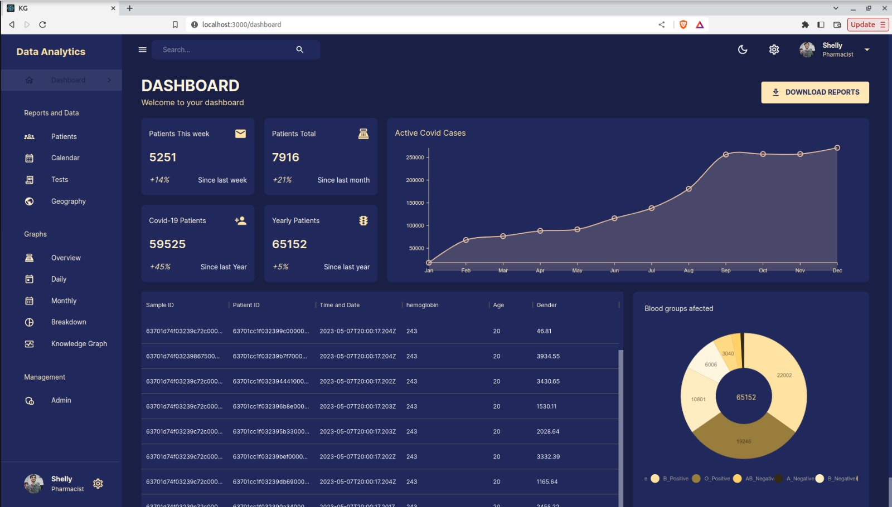
Website UI

Slide 12

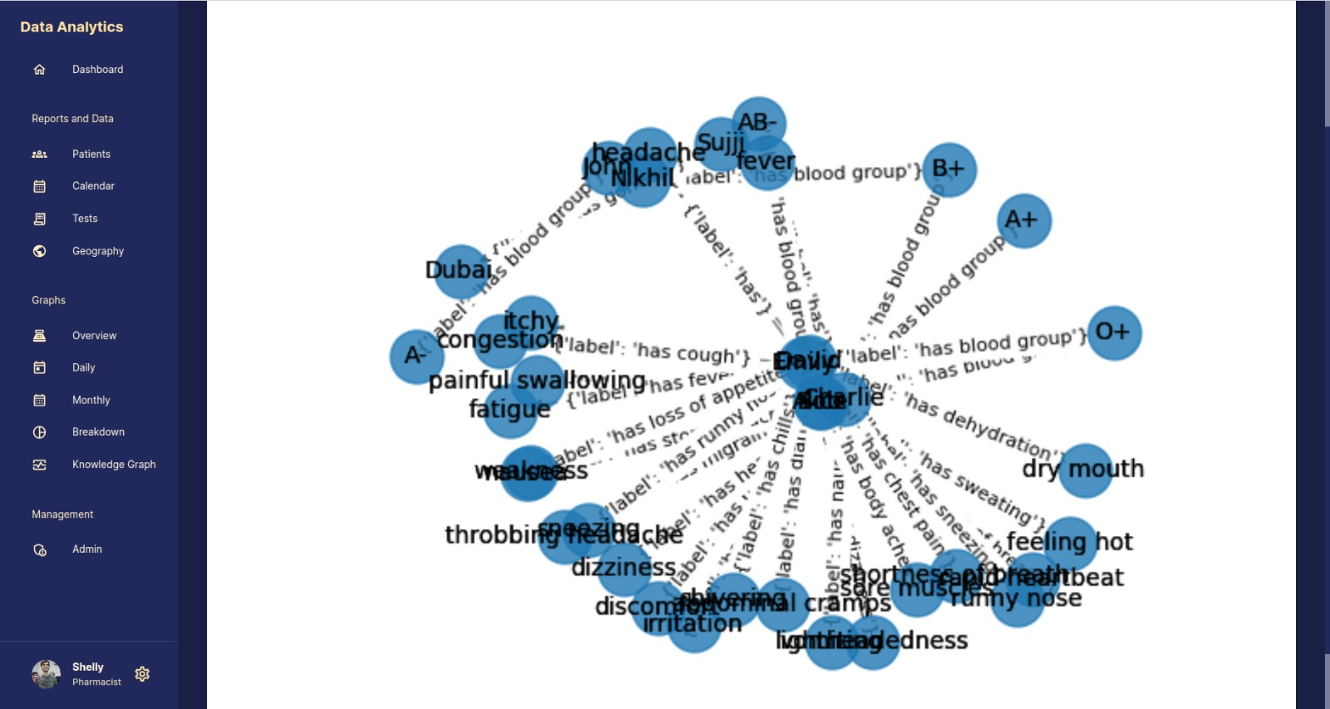
Knowledge graph

Slide 13

cONTRIBUTIONS
Nikhil Agrawal : Frontend Implementation, Debugging and testing, API calls
Mitul Garg : Knowledge Graph, Readme, Presentation, UI.
Atharv Sujlegaonkar : Backend Implementation, Debugging ,connecting knowledge Graph to server.

Slide 14

Thank you

